Slide 1

Cloud native Platform Engineering on Azure
Will Velida – Senior Software Engineer, Microsoft - @willvelida
Notes:
Good morning everyone! Welcome to NDC Melbourne! How are we all today?
Cold out there right?

Slide 2

About Me!
Senior Software Engineer at Microsoft, working in the Industry Solutions Engineering team.
Previously a Microsoft Azure MVP focusing on Kubernetes and Open Source.
Conference speaker and YouTuber: https://www.youtube.com/@willvelida
Notes:
Everyone does action figures, which was pretty cool, but I’d thought I’d give Lego Heads a try (you know the star wars ones? Any Lego fans here?)

Slide 3

Agenda
Current Challenges
What is Platform Engineering?
Building a Platform on Azure
Demos
Q&A
Notes:
What are we talking about today? I’ll first talk about some current challenges that we’re facing when building apps in the cloud (and also scale them out)
I’ll then talk about what Platform Engineering is
Then we’ll cover how we can start to build platforms using Azure and I’ll show off a couple of demos on what that might look like
Before wrapping up and Q&A at the end.

Slide 4
Current Challenges

Slide 5
Challenges with cloud operations
Read this document on our common app foundations and shared app services. BTW – We’re introducing more in a few weeks.
Cloud operations team has strict requirements for applications. Read this documentation. We’ll need to do an audit before you can set up your dev environment.
We have weekly security office hours. We can discuss your needs there.
Cloud Ops
Our DevOps team is pretty booked. We can get you setup with a standard pipeline, but we will need to book a meeting to discuss your requirements.
Architecture
DevOps
Security
Other roles
?
Uh oh. Our management asked us to start
by the end of this week. What now?
How can we keep all this up to date as things change?
I just want to code.
?
?
Dev Lead
Notes:
This may be familiar to developers in the room
Ask people what type of orgs they work for?
Different stakeholders have different requirements, which inevitably conflict with our own timelines

Slide 6
What is platform engineering?

Slide 7
Platform engineering streamlines development by creating tools that increase systems resiliency and enhance efficiency to accelerate value delivery
Notes:
Platform engineering is a practice, built up from DevOps principles, that seeks to improve each development team’s security, compliance, costs, and time-to-business value through improved developer experiences and self-service within a secure, governed framework. It's both product-based mindset shift and a set of tools and systems to support it.

Slide 8
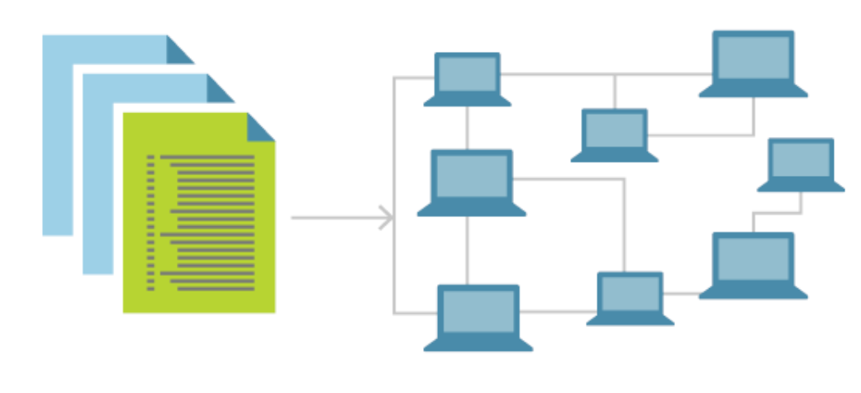
Core Principals of Platform Design
Each customer is important
Adopt a product mindset
Empower developers through self-service with guardrails
Improve discovery, eliminate waste through inventories
Notes:
Think of developers as your primary customer and focus on their needs first when deciding what development paths you want to pave, and what capabilities you want to grow.

Slide 9
Business values of platforms
Reducing operational costs
Accelerating feature delivery
Ensuring on-demand scalability
Minimizing manual effort
Enhancing competitive advantage
Notes:
Getting buy in from organizations for an internal platform team can be tricky
From a business perspective, the value we get from platforms is derived from accelerating time to market while maintaining the guardrails required to operate within our business environment.
There’s a lot more to business value than writing super awesome code, we need to be safe as well.

Slide 10
Common goals for Platform Engineering practices
SELF SERVICE WITH GUARDRAILS
CULTURE SHIFT TO PRODUCT MENTALITY
Self service: keep developers focused on delivering value quickly
Secure, governed development, but with team-level flexibility.
Rapid, secure project and team member onboarding/offboarding
Simplified shared API, service discovery, adoption, publishing across teams.
Improve collaboration while maintaining tool choice
Costs optimized across various tools, vendors, and teams.
Engineering Platform managed as a product.
Developers are the primary customer – automate away as much as possible
Security, architecture, operations are key stakeholders, provide input.

Slide 11
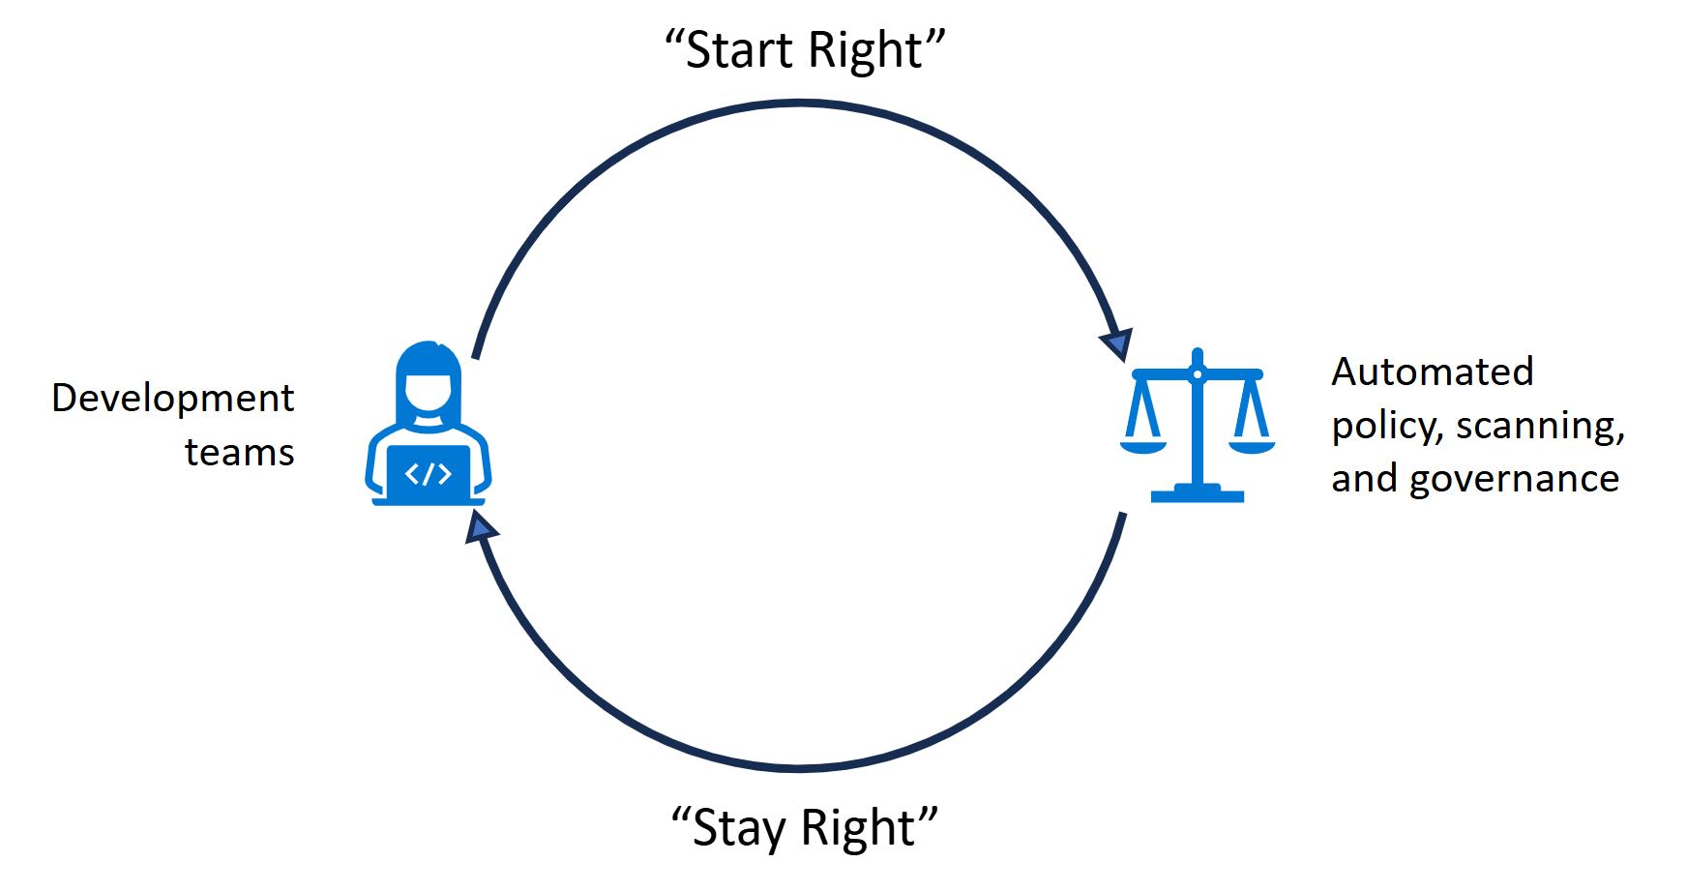
Platform Engineering motions
Start Right Templates
Stay right governance
Get right alignment
Equipping developers with self-service tools
Maintaining compliance
Getting Compliant
Notes:
Some teams have the luxury of starting right – being able to equip their devs with the right tools
Some have to get right – and slowly integrate compliance, security, best practices etc over time

Slide 12
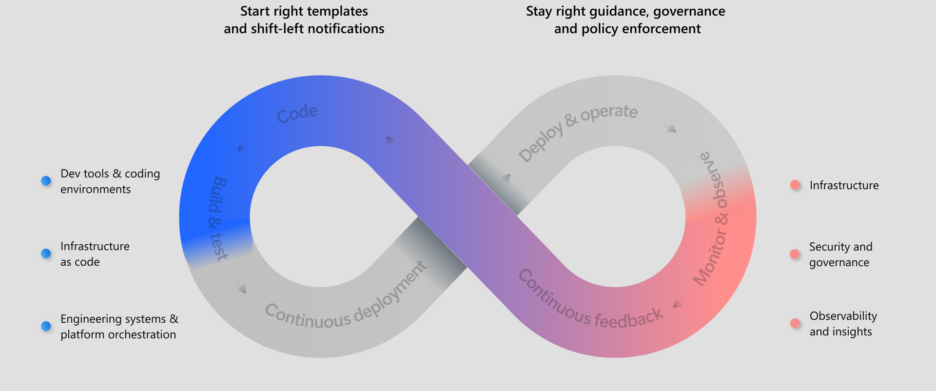
Platform Engineering Lifecycle
Notes:
No two companies are the same, so consider the specific needs of your internal customers to plot an incremental course through this journey. By establishing a set of core building blocks that you'll assemble over time, you can ensure your internal developer platform has enough value that development teams will become advocates and will want to use it along the way. Use this information to create a thinnest viable platform, a minimum viable product for your platform) and grow from there.
The important point is that you want to think about whatever investments you make in these areas as key building blocks for your platform engineering journey. Then you can focus on creating cohesive glue with your custom investments to add unique value for your business, rather than building everything from scratch.

Slide 13
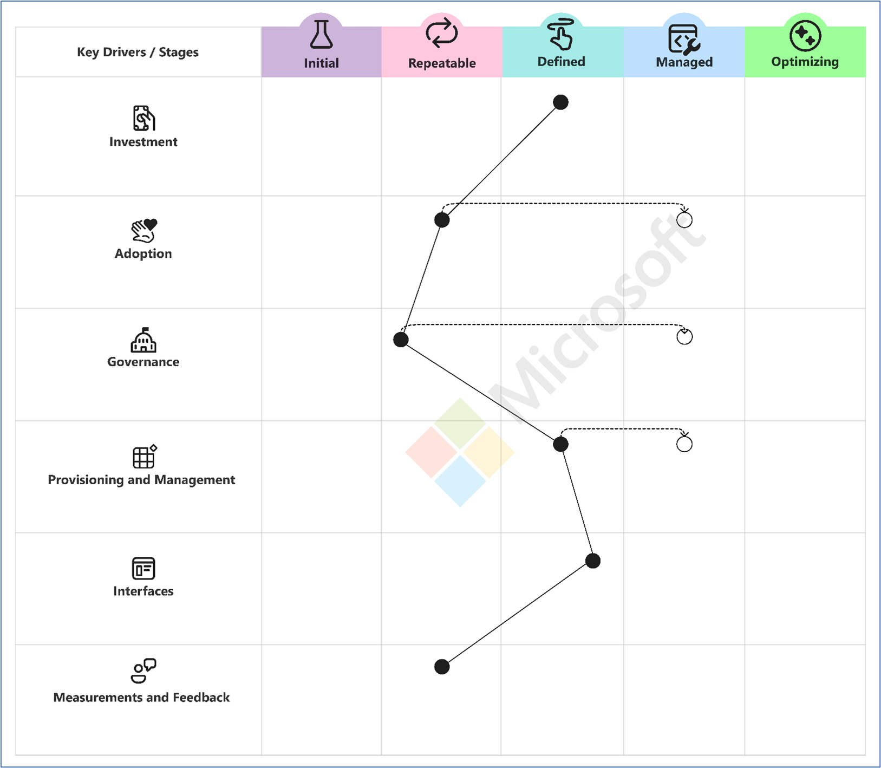
Platform Engineering Capability Model
Gradual, iterative approach
Incremental progress with MVPs
Lifecycle ensures reliability and scalability
Model outlines maturity levels and best practices
Assess, plan, and implement efforts
https://aka.ms/PECapabilitySurvey

Slide 14
Stages of maturity
Initial
Repeatable
Limited structure, ad-hoc processes
Minimal investment in capabilities
Driven by individual engineers
Addressing immediate needs
Basic process emerge
Inconsistent adoption and governance
Dedicated teams address challenges
Limited budget and staffing

Slide 15
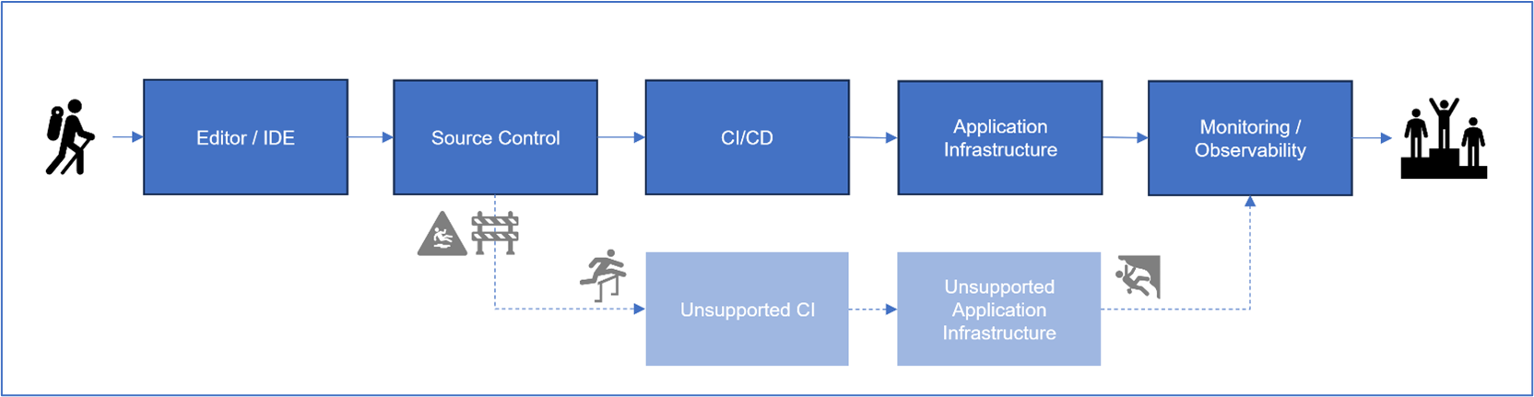
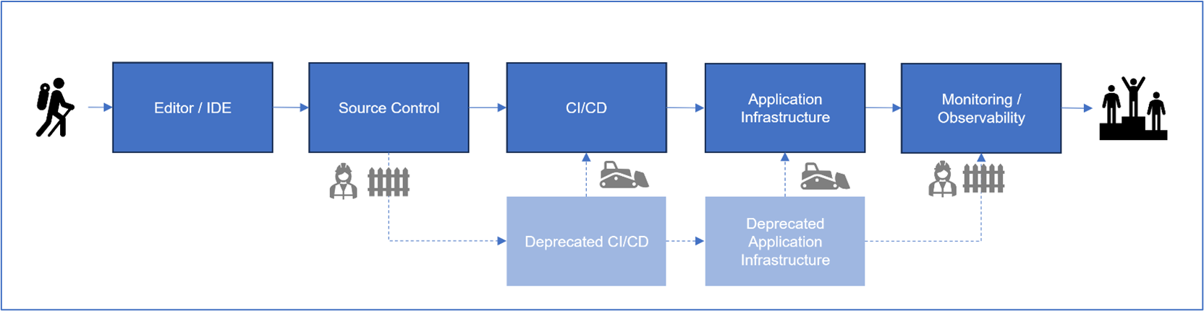
Blaze Paved Paths
Notes:
While your organization might have various different development paths to production today, an early step in your platform engineering journey is to understand which paths you want developers to use.
Making this call is important since it allows you to focus your energy on paving an efficient path through them that still meets development, operations, and governance requirements.
Convert effective approaches into standardized, scalable workflows.
- Integrate security, best practices, and compliance.
- Balance innovation and standardization.
- Encourage community contributions for platform improvements.

Slide 16
Secure and Scalable Platform Design
Integrate security into every layer
Ensure scalability for evolving needs
Combine security, scalability, and automation for resilience
Meet current requirements and build for future growth
Notes:
- Mention the need for security at every layer
- Emphasize scalability for evolving business needs
- Discuss combining security, scalability, and automation for resilience

Slide 17
Security considerations in Platforms
Implement proactive measures and ensure consistency
Codify Security Configurations and Policies
Automate enforcement of security standards.
Identity and Access Management (IAM)
Secrets and Key Management
Notes:
- Discuss the need for consistent security measures
- Explain the concept of Security as Code and Policy as Code
- Highlight the role of IAM
- Mention secrets and key management

Slide 18
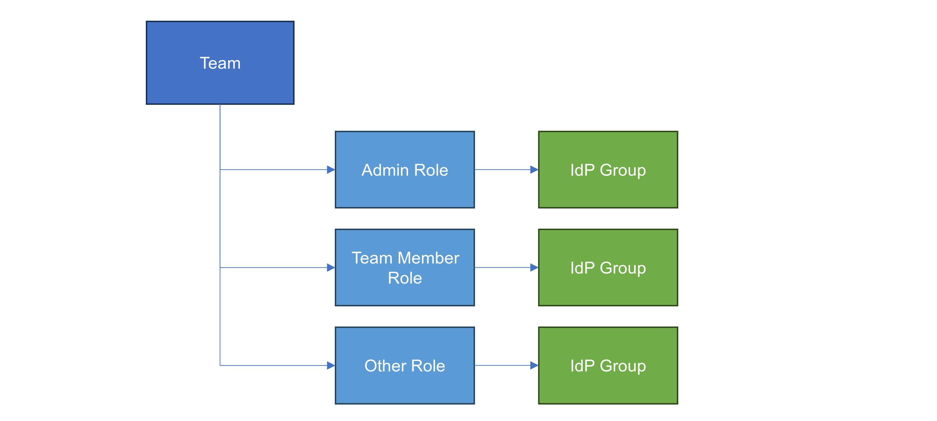
Security and Policy as Code
Notes:
Embed security practices in development lifecycle
- Codify policies into configuration files
- Automate enforcement and governance
- Azure Policy, Open Policy Agent (OPA)
- GitHub Advanced Security, GitHub CODEOWNERS

Slide 19
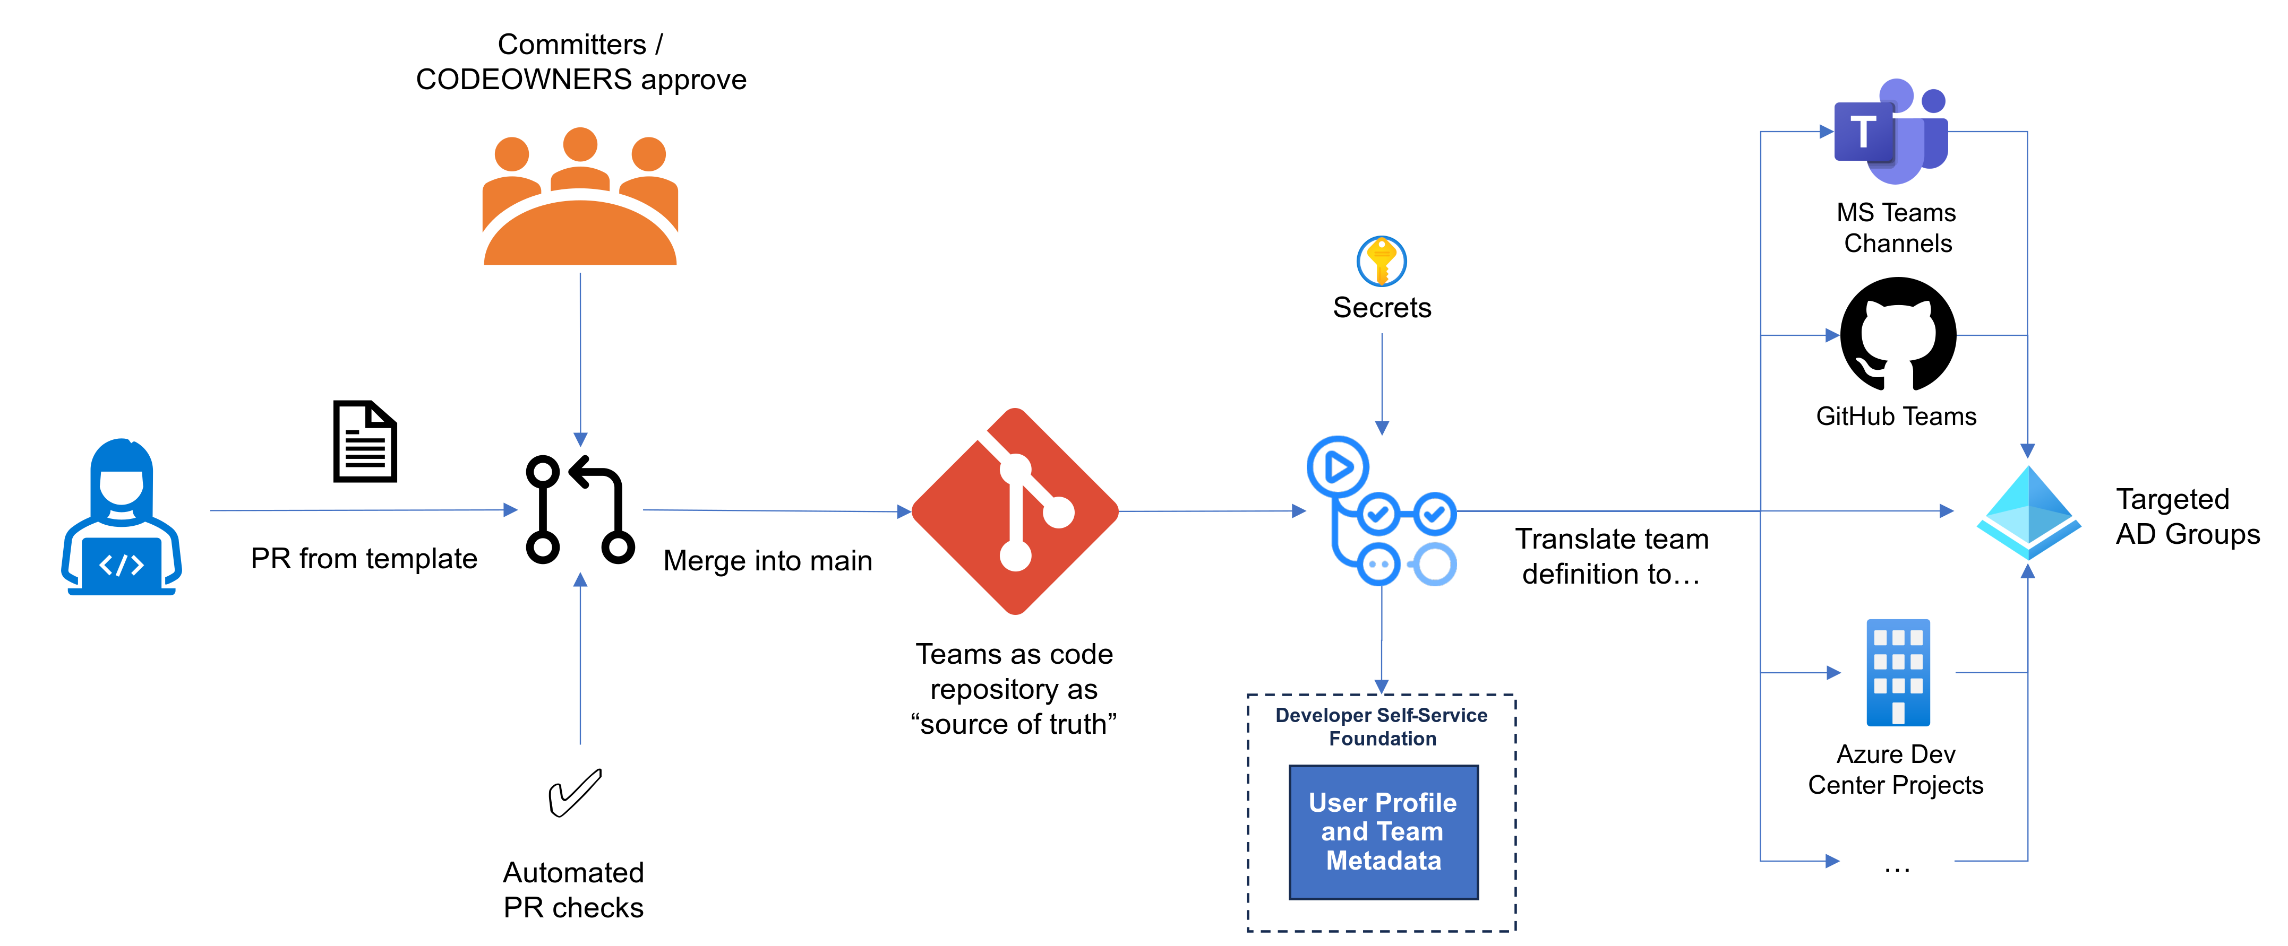
Identity and Access Management
Notes:
Manage identities and access securely
- Use role-based access control (RBAC)
- Centralize secrets and key management
- Integrate with identity providers
- Use Teams as Code (TaC) pattern

Slide 20
Monitoring and Auditing
Monitoring Self-Service Activities
Auditing and Compliance
Automated Remediation
Implement real-time logging and alerting
Azure Monitor and Log Analytics
Visualize KPIs with custom dashboards
Ensure compliance with industry standards
Use Azure Policy and Microsoft Defender for Cloud
Conduct regular audits of self-service workflows
Automate policy enforcement with Azure Policy and OPA
Implement automated rollback mechanisms
Ensure consistent application of policies.

Slide 21
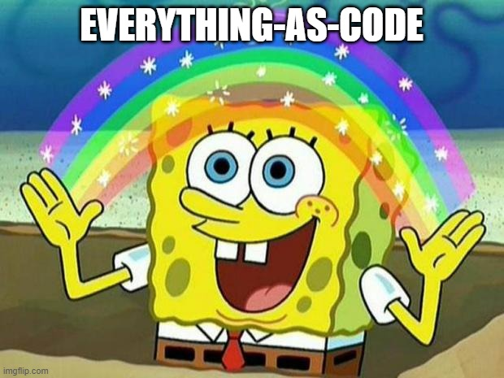
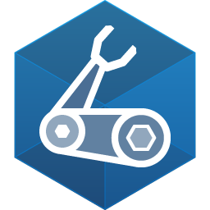
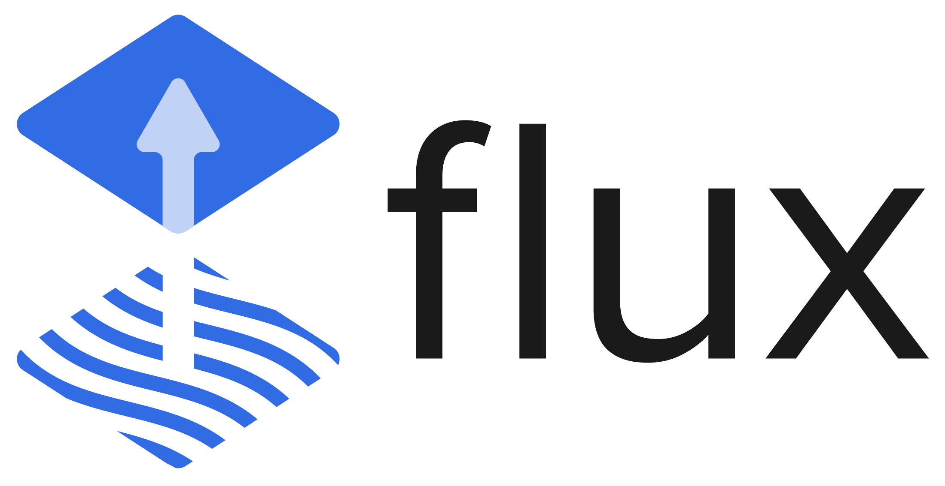
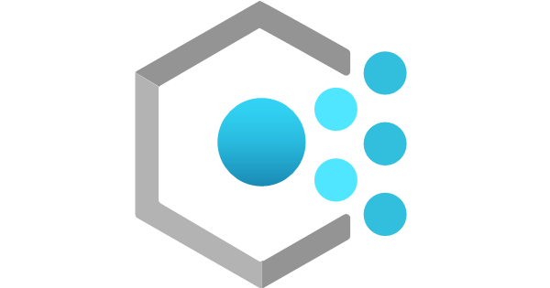


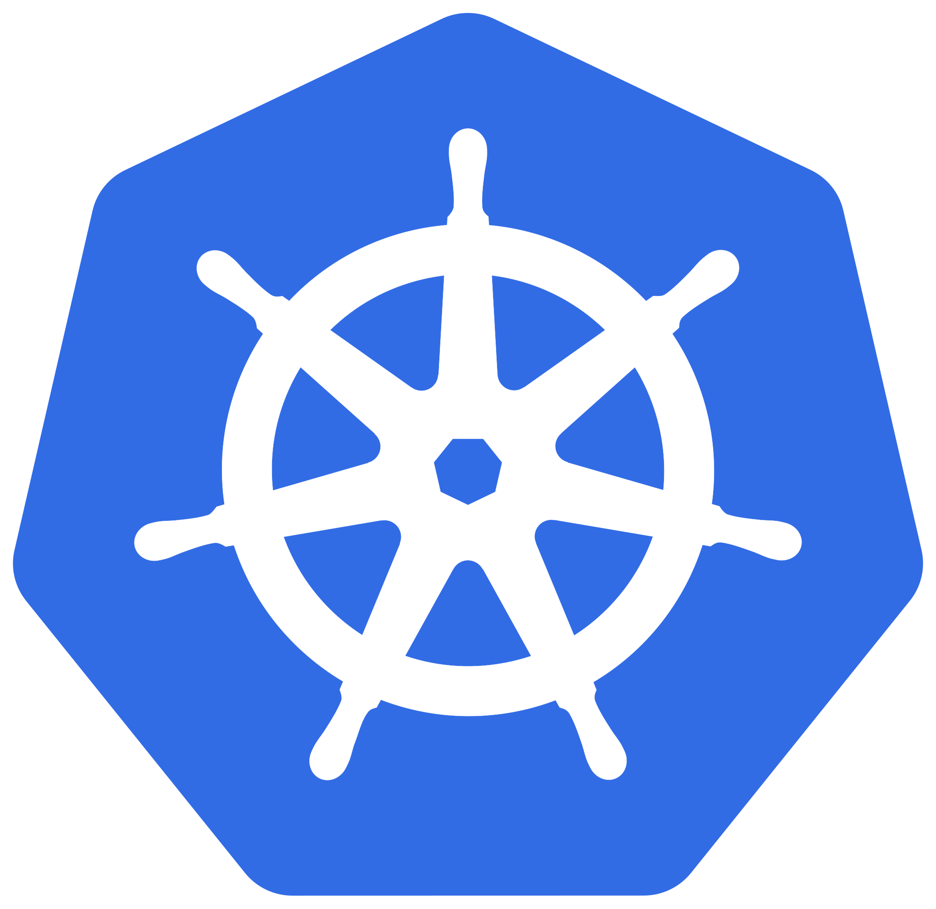

Everything-as-Code!
Notes:
Enabling Self-Service with Infrastructure as Code (IaC) and GitOps
1. Why IaC is Critical for Self-Service
Infrastructure as Code (IaC) with Continuous Delivery (CD) pipelines and GitOps tools helps enable self-service provisioning.
Developers can use tools like Bicep, Terraform, and Helm charts to create and destroy cloud resources on demand.
Because cloud configuration is treated as code, it benefits from:
Version control – Track changes over time.
Security & auditability – Review who made changes and why.
Automation – Reduce manual infrastructure work and prevent drift.
2. Extending the ‘As Code’ Approach Beyond Infrastructure
IaC isn't just for provisioning infrastructure—the same concept can be applied to:
Security as Code – Automate security configurations.
Policy as Code – Enforce governance with tools like Azure Policy and Open Policy Agent (OPA).
How it works:
Developers push a YAML or JSON configuration to a repository.
A workflow is triggered that processes the file and enforces policies automatically.
Examples:
dependabot.yml (automating dependency updates).
CODEOWNERS (defining code review responsibilities).
Centralized policy repositories for governance enforcement.
3. Everything as Code (EaC) and Self-Service
By adopting Everything as Code (EaC), you create a centralized catalog of reusable templates.
Developers can self-serve infrastructure, security, and policies while adhering to best practices by default.
This approach reduces cognitive load, allowing developers to focus on delivering value instead of managing configurations.
4. Key Takeaway
IaC + GitOps + Self-Service = Empowered Developers & Scalable Infrastructure
Automate everything to improve speed, security, and governance.
Enable developer self-service by offering a curated set of best-practice templates.

Slide 22
Building a platform on Azure

Slide 23
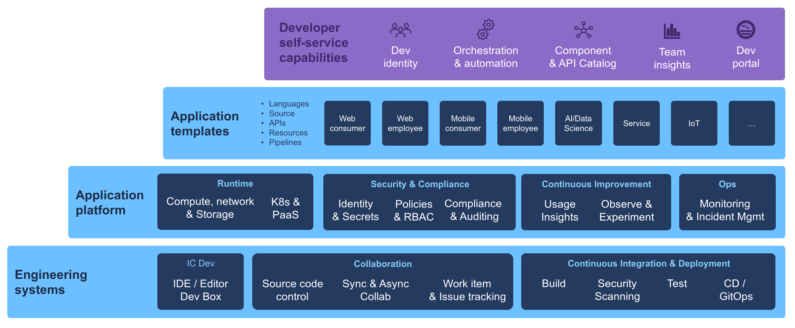
Implementation Strategy

Slide 24
Developer Coding Environments
Automated Setup of Developer coding environments
Automating setup streamlines onboarding
Pre-configured environments reduce configurations
Focus on development over troubleshooting
Use templates for consistency
Templates promote best practice
Include source code, CI/CD configs, and testing setups
Ensures security, monitoring, and collaboration tools

Slide 25
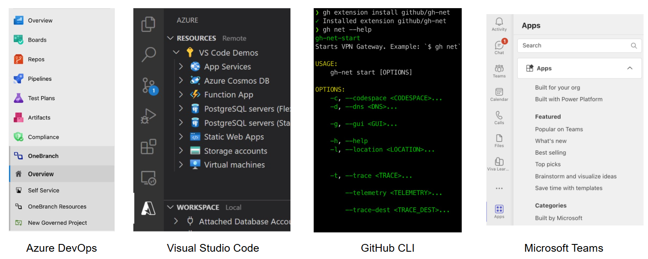
What tools do we already use?
It’s easier to extend what you have, rather than introduce something new
Notes:
evaluate whether you can enhance and extend what you have before you start building new experiences from scratch. (Ask yourself, will people react better to another new user experience or an improved version of something they have now?)
Some of the tools, utilities, or web apps you want to continue using will be custom, and these are good candidates for enhancement. But don't forget to pay attention to whether your favorite tools and services have an extensibility model you can use.
You'll get a lot of benefit from starting there. This can eliminate maintenance and security headaches and let you focus on the problem you're trying to solve
For example, you might be able to extend the following surfaces you're already using:
Editors and IDEs.
Your DevOps suite.
CLIs are increasingly extensible too.
Low/no-code environments like Power Pages.
Each might provide a better starting point for a given role than something you set up from scratch since they're existing centers of gravity.

Slide 26
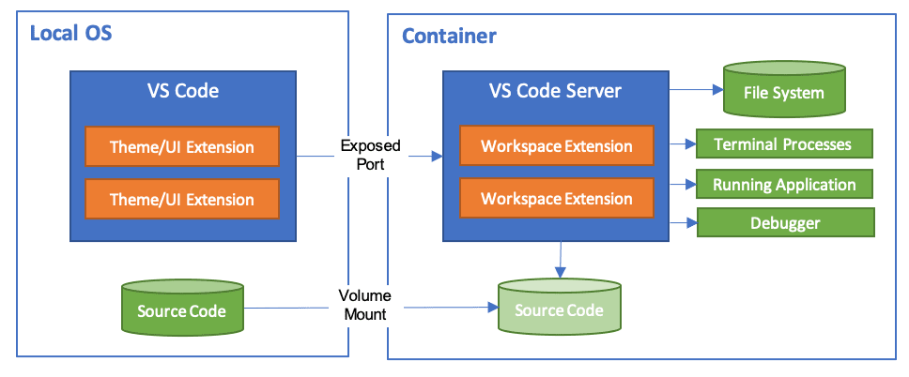
Dev Containers
VS Code Dev Containers let you use containers as a full-featured dev environment.
Open your code inside a container with preconfigured tools and runtime stack needed for your code base.

Slide 27

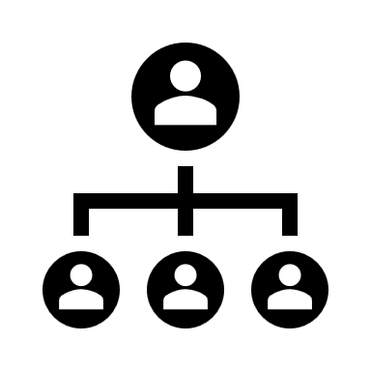






Microsoft Dev Box
Platform Engineers
Dev team leads
Developers
Manage dev boxes via Microsoft Intune and Endpoint Manager
Set and manage security policies
Create pools of dev boxes tailored to projects and tasks
Configure dev boxes by project
Customize Developer Experience
Deploy dev boxes they need to work on projects and tasks
Deploy dev boxes from developer portals
Organizational Policies
Network Configuration
Security Policies
Notes:
Dev Box give developers self-services access to cloud workstations called dev boxes. You can configure these dev boxes with tools, source code, prebuilt binaries etc, that are specific to a project so that developers in your team can hit the ground running with their work immediately, so no more needing to wait 2 weeks for someone in security or identity to manually approve your corporate access!
You can use preconfigured images from the Azure Marketplace, or use your own customized images. As a developer, you can use multiple dev boxes for your work, and can access it through remote desktop clients, or web browsers like any virtual desktop.
Dev Box was created with three roles in mind. Platform Engineers, Dev team leads and developers.
Platform Engineers and IT admins work together to provide developers with the tools and infrastructure they need to do their work. This includes setting and managing security settings, network configurations, and organizational policies to ensure that the dev boxes can access resources securely.
Dev team leads will have in-depth knowledge about their projects. They can serve as Admins, and assist with creating and managing the developer experience. They also create and manage pools of dev boxes.
Then developers are the people who will use the Dev Boxes. Developers can self-serve one or more dev boxes on demand from the dev box pools that are enabled for a project. Dev box users can work on multiple projects or tasks by creating multiple dev boxes.
The intention behind Dev Box is to bridge the gap between development teams and IT operations teams, and prevent long waiting times just to get onboarded and get the work done!

Slide 28
Automation with Infrastructure-as-Code
Iac Approach
Self-service platform and tools
IaC enables programmatic infrastructure management.
ARM, Bicep, and Terraform all provide declarative infrastructure definitions.
Integration with CI/CD pipelines for automated resource provisioning.
Bicep Modules, Terraform Modules, Azure Verified Modules
Self-service platforms like ADE and DevBox enable efficient resource provisioning.
ADE uses IaC templates for consistent environments.
Dev Box integrates with identity management and policy enforcement tools.

Slide 29
Infrastructure Management Approaches
Push-based approach
GitOps
ChatOps
Directly apply changes to infrastructure
Initiated by developers or CI/CD pipelines
Flexibility with some manual intervention
Automatically detect changes in the repository
Emphasizes declarative configuration and version control
Improved observability and rollback capabilities
Integrates resource management with collaboration tools
Allows tasks within communication platforms
Enhances user experience and operational efficiency.

Slide 30
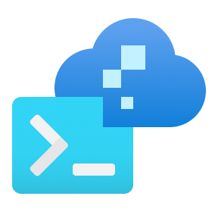
Azure Developer CLI
Open Source tool that accelerates provisioning and deploying app resources on Azure.
Reusable infrastructure as code assets
Integration with GitHub Actions or Azure Pipelines.
Can create templates for app code, azd configuration, and infrastructure files.

Slide 31
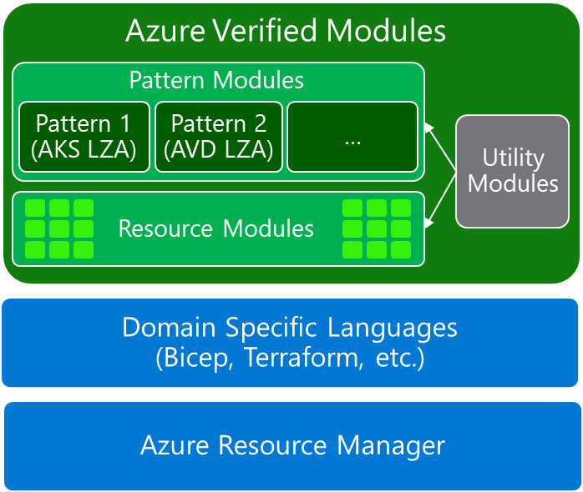
Azure Verified Modules https://azure.github.io/Azure-Verified-Modules/
Azure Verified Modules (AVM) is an initiative to consolidate and set standards for good IaC.
Enable and accelerate consistent solution development and delivery of apps by codifying Well-Architected Framework practices
Two types of modules: Resource and Pattern Modules.

Slide 32
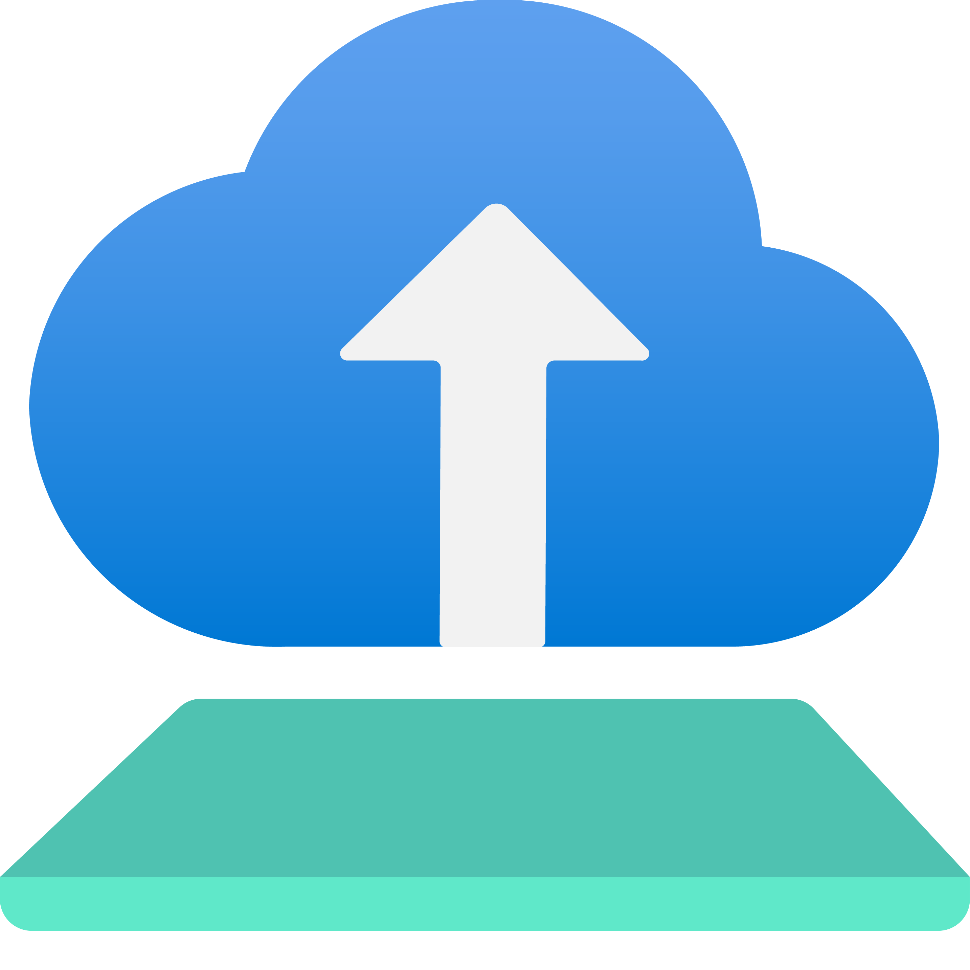
Azure Deployment Environments
Self-service app infrastructure
Standardize templates
Secure with confidence
Notes:
ADE allows developers to self-serve this application infrastructure through standardized, project-specific Infrastructure-as-Code templates set by their dev leads or platform engineers. Developers simply just choose the appropriate template for their testing and create a new environment, and platform engineers can configure enterprise settings to ensure that the resources created are compliant, secure, and complementary to the framework you’ve put in place.

Slide 33
Azure Deployment Environments
Extensibility model
Platform Catalog
Development or Test Subscription
Container image
Container registry
IaC Templates
Sandbox, demo, perf, other environments
Portal/CLI
Build
Developers
Code
Debug
Continuity between inner and outer loops
Environment Type Mappings
Platform Engineers
Automated Deployment Pipelines
Subscription
Curate templates and map environment settings by type
Identity
Dev Sub
Test Sub
Prod Sub
Permissions
Git push
Dev Env
Test Env
Prod Env
Secrets
Notes:
As a platform engineer working with ADE, I’ll configure the service to best serve my developers before they start creating environments. I can bring in infrastructure templates from a source control repo and curate different environment definitions to suit different developer scenarios, whether that means recreating the entire application or just spinning up the infra needed to run a microservice. These templates can be in any preferred IaC framework leveraging ADE’s extensibility model, and I can set up special scripting for additional compliance or infrastructure steps to customize deployments for specific scenarios. I can set up environment types I would like my dev teams to create based on the stage of their development, and within those types configure the subscription the resources are deployed into, configure the identities used in deployment to provide elevated but controlled access, and configure permissions developers and the rest of the team will have over the resources once the environment is created. We can even configure some tagging of the resources we create via ADE that can allow us to track their usage later.

Slide 34
Cloud-native application platform
that works on any cloud

Slide 35
Team
Collaboration
Infrastructure Recipes
Application
Graph
Cloud
Neutral
Radius Application and Environments allow developers to work with operations on application definition + delivery
Swappable infrastructure with popular IaC tools that follows org best practices and IT policy
by default
Understand
how services and infrastructure in an application are interconnected
Deploy across development, on-premises, and cloud environments with a consistent experience

Slide 36

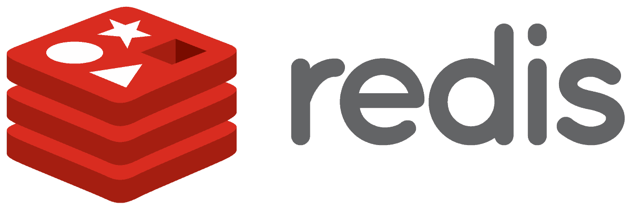






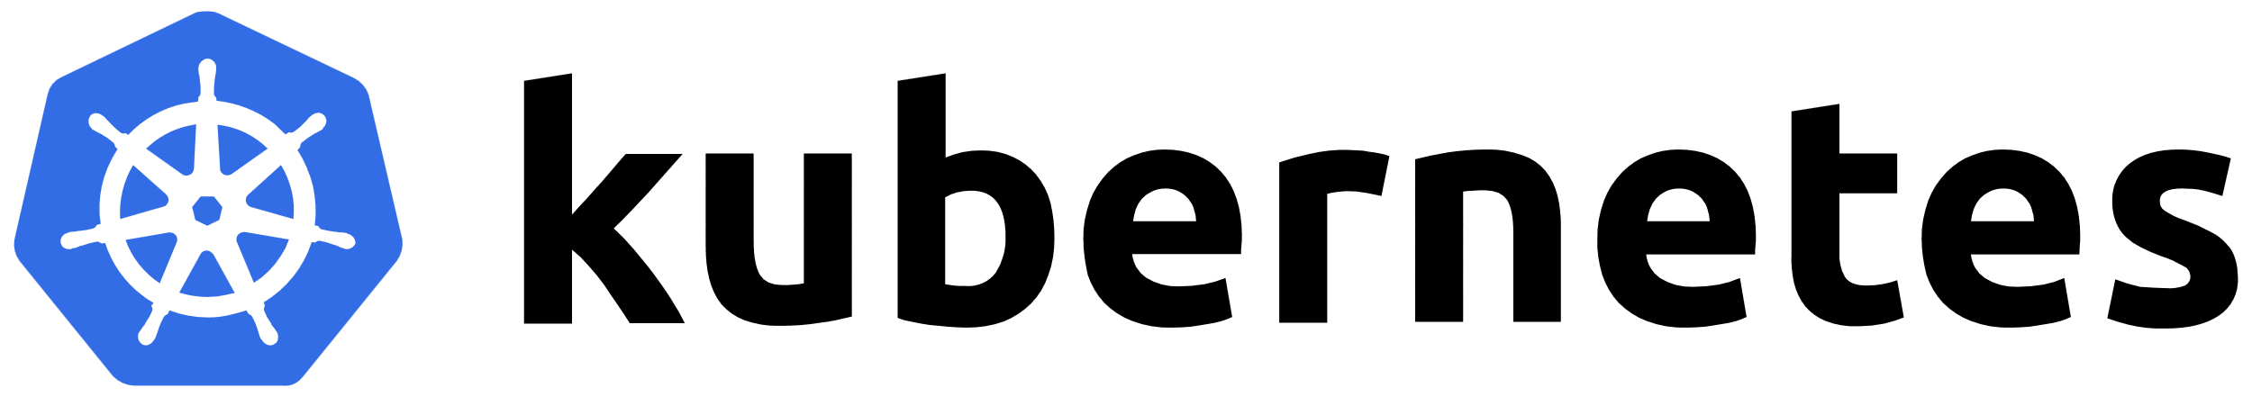
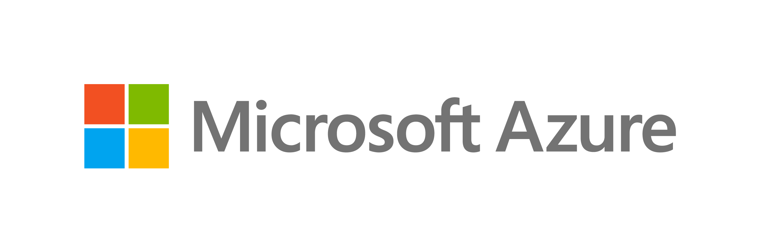


Cloud-native applications
containing
Team
Collaboration
Infrastructure Recipes
Application
Graph
Cloud
Neutral
Any cloud or edge infrastructure

Slide 37
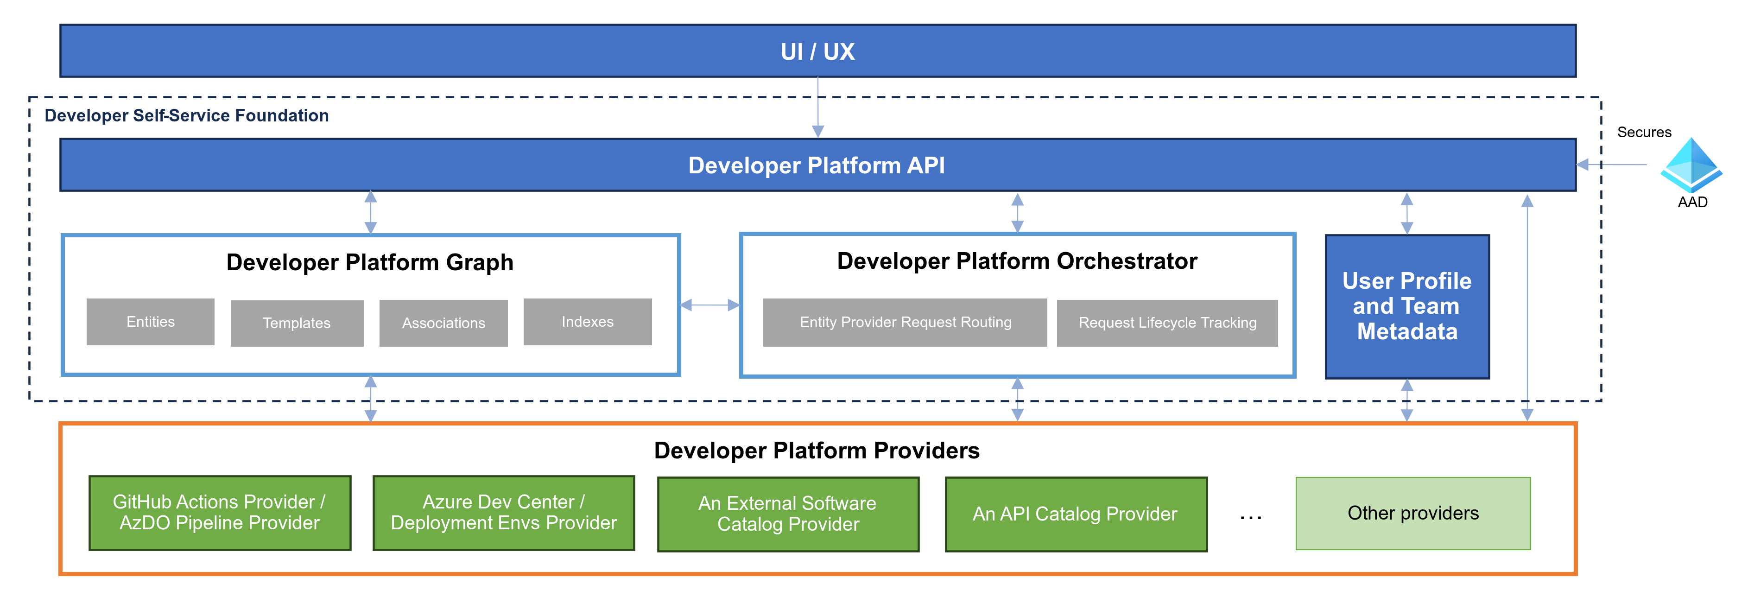
Developer Self-Service Platform Architecture

Slide 38
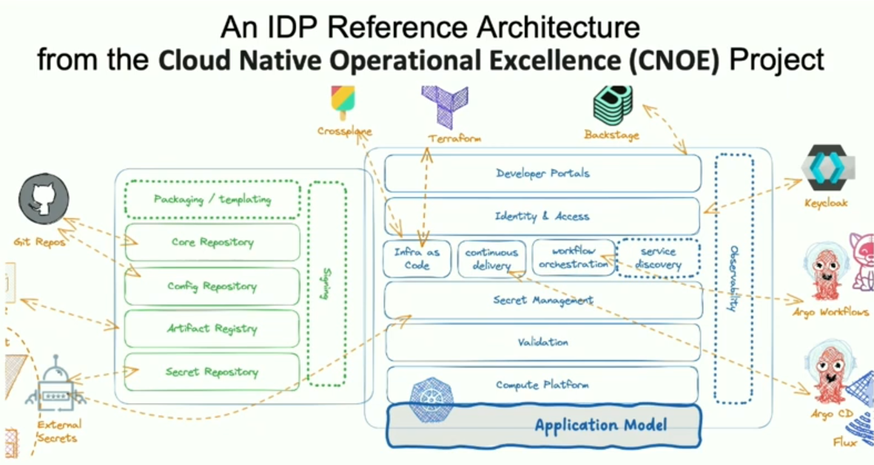

Slide 39


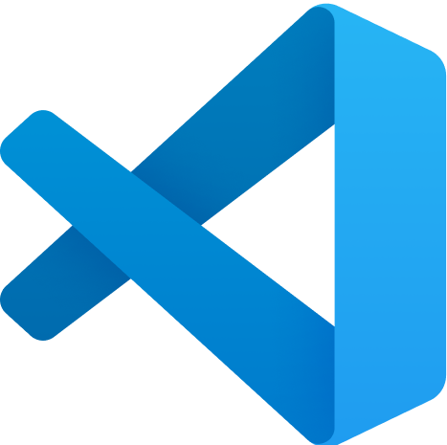



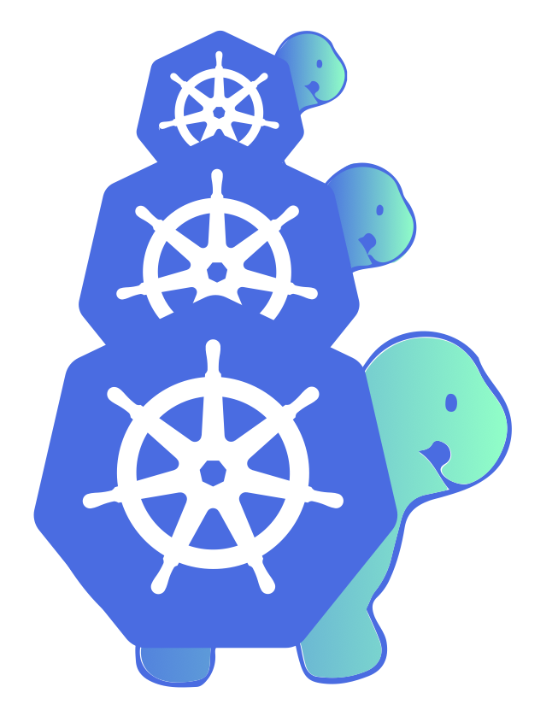





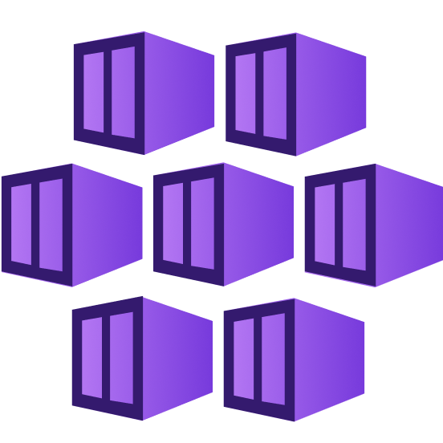

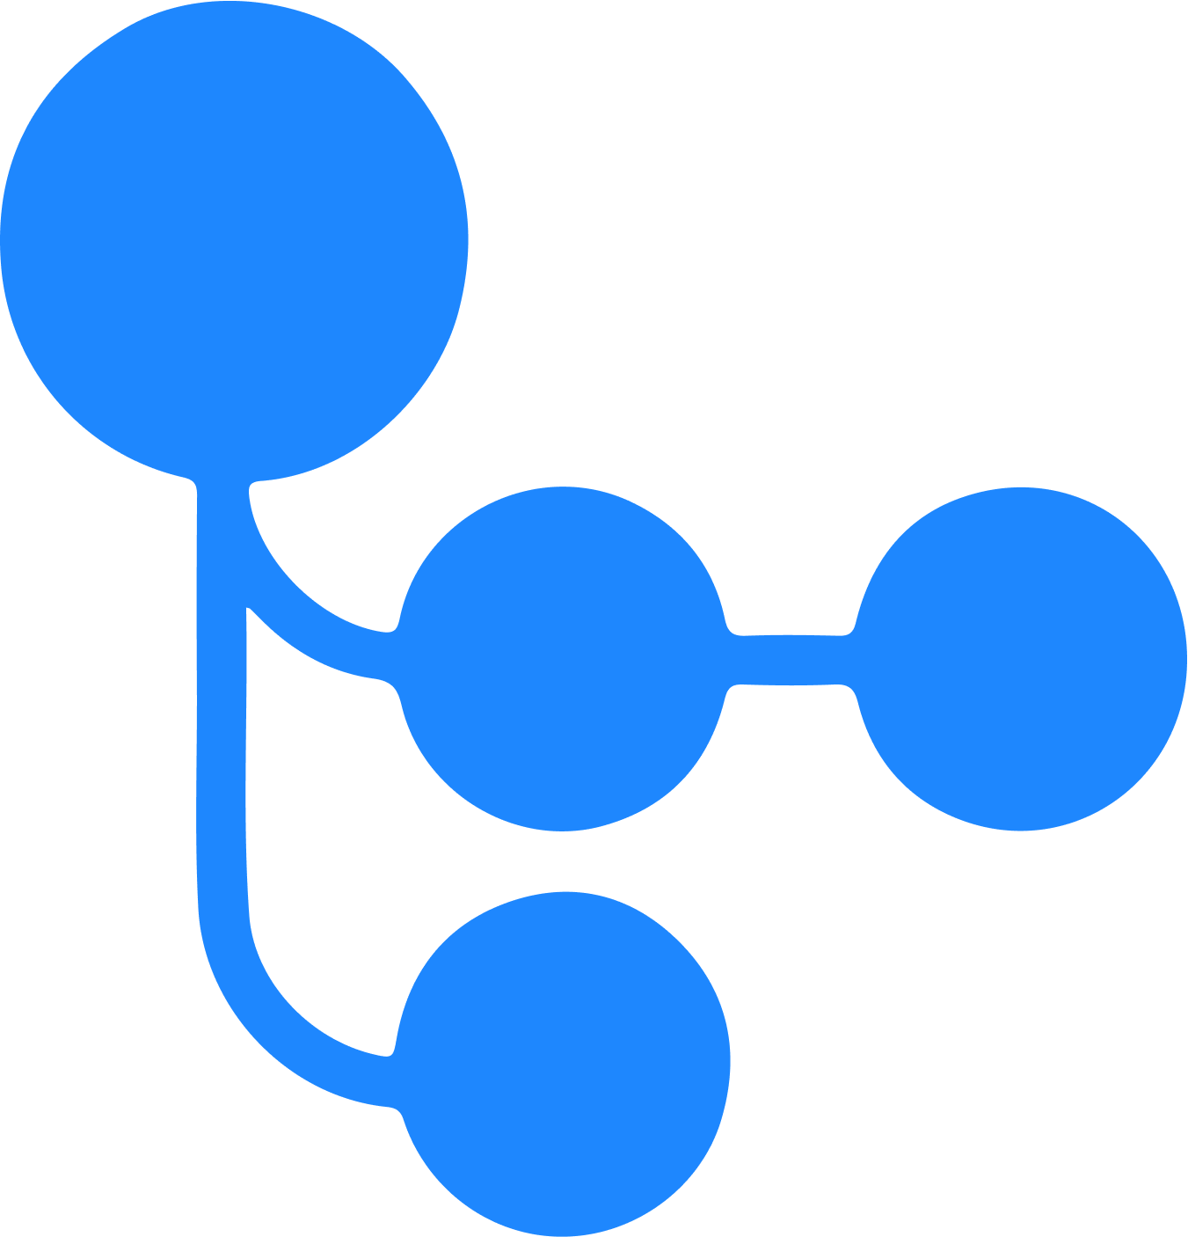
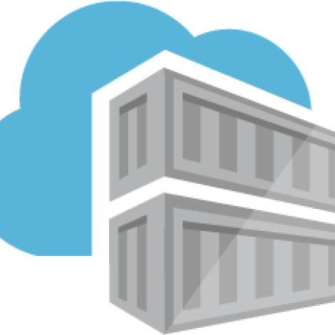
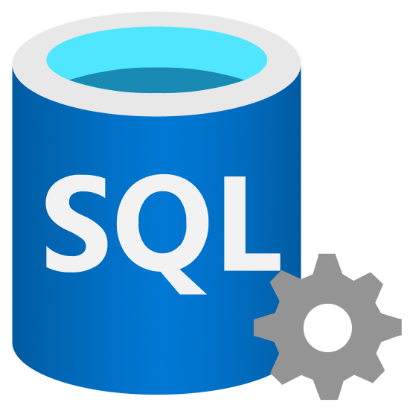
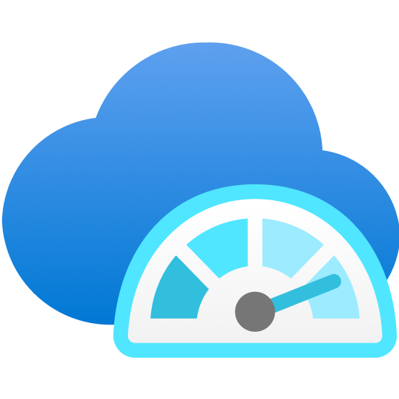



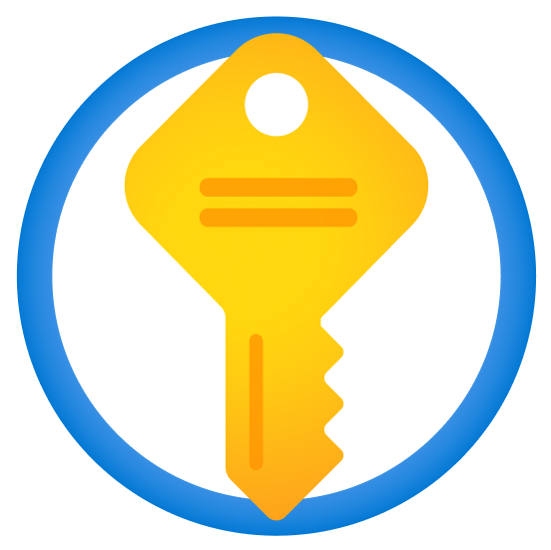


IDE
Service Catalog / API Catalog Developer Portal
5
Backstage
Developer Control Plane
Version control
Visual Studio Code
Platform Source Code
Application Source Code
Cloud Native IaC
IaC
Kubernetes YAML, Helm Charts, ArgoCD Applications
GitHub
4
Dev Team Workload / Resource Plane
2
CI Pipeline
Registry
Compute
Integration and
Delivery Plane
AKS
control plane cluster
+
Cloud-native IaC
+
GitOps
Azure Kubernetes Service
GitHub Actions
Azure
Container
Registry
3
1
ADE
Data
Platform Orchestrator
Azure SQL
Networking
Monitoring and
Logging Plane
Observability
Azure Monitor
Prometheus
Azure DNS
Services
Security Plane
Secrets & Identity Manager
Azure Key Vault
External Secrets Operator
Azure Service Bus
Notes:
Here’s an architecture of what we have showed today built on format from the community of platform engineering.org.
#1 At point 1 you can see ADE providing the automation and connecting to platform source code, in fact using the ADE extensibility model you can run cloud native IaC too – this is what we showed you.
#2 Argo is responsible for apps CD
#2 Now – you can go further with cloud native IaC, if you are not familiar you can use the K8s control plane to deploy azure resources, so resources are represented as K8s objects, thus you can use K8s tools, such as helm, to deploy them.
#4 These tools have many benefits compard to using TF and automation, for example if you pair them with GitOps you get constant drift detection and reconciliation,
#4 Also these tools allow you to reduce the number lines of code in templates you need using techniques such as x-plane comps, argo app sets, please see our build presentation.
#5 BACKSTG – you can expand to using Backstage if you need the capabilties it provides, such as documentation, tech radar, open source plugins to your systems (such as Headlamp to view K8s clusters contributed by MS, or Argo), it can interact with ADE APIs

Slide 40
DEMOS
https://github.com/willvelida/cloud-native-platform-engineering-azure

Slide 41
Recap of the common goals
SELF SERVICE WITH GUARDRAILS
CULTURE SHIFT TO PRODUCT MENTALITY
Self service: keep developers focused on delivering value quickly
Secure, governed development, but with team-level flexibility.
Rapid, secure project and team member onboarding/offboarding
Simplified shared API, service discovery, adoption, publishing across teams.
Improve collaboration while maintaining tool choice
Costs optimized across various tools, vendors, and teams.
Engineering Platform managed as a product.
Developers are the primary customer – automate away as much as possible
Security, architecture, operations are key stakeholders, provide input.

Slide 42
Platform Engineering motions
Start Right Templates
Stay right governance
Get right alignment
Equipping developers with self-service tools
Maintaining compliance
Getting Compliant

Slide 43
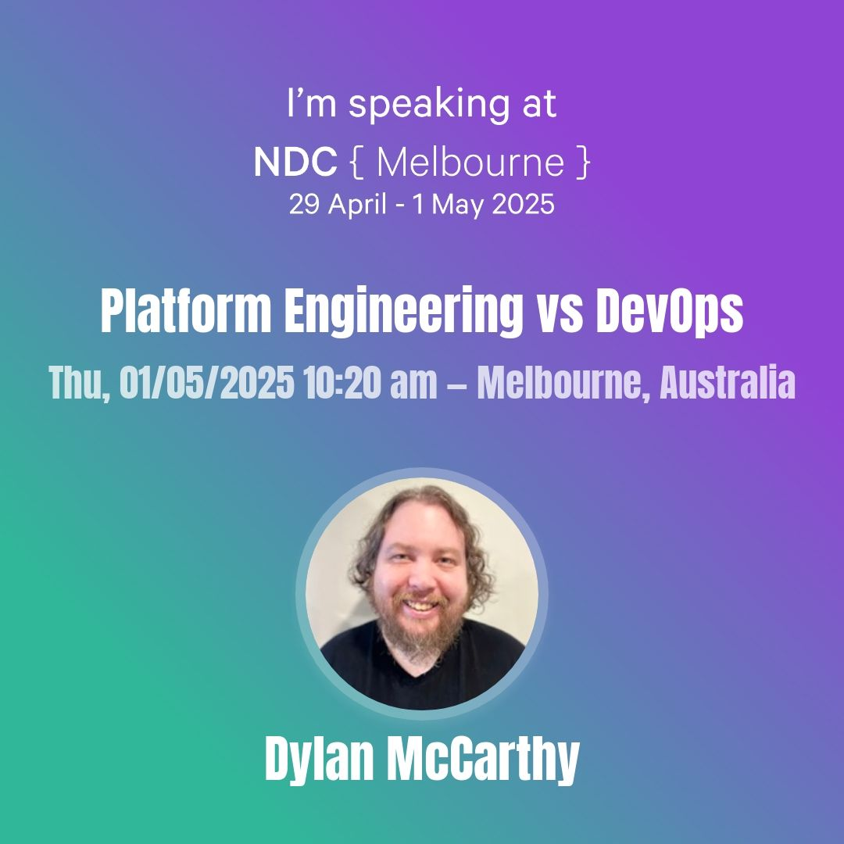
Check out Dylan’s session tomorrow!

Slide 44


Thank you

